Slide 1

Using Cloud for Business Growth
Sarah Lean
Senior Cloud Advocate
@Techielass

Slide 2

The question is no longer “if or when”, it’s “how”
Digital transformation is an economic imperative
90% of organizations already use the cloud
The cloud is the safest place for your business
Benefits of the cloud are proven

Slide 3


Who am I
Senior Cloud Advocate @ Microsoft
Blog at www.techielass.com
@Techielass
Founder of the Glasgow Azure User Group
STEM Ambassador
14+ years in the IT industry
IT Pro

Slide 4
…”We’ve gained huge amounts of efficiency—85 percent of outages and downtime have been eliminated. The profitability of our hosting business increased by 30 percent within three months. Also, the engineering hours required to run all that infrastructure were reduced by half…”
- Base2

Slide 5






Reliable infrastructure
for your innovation
On-demand
global scale
Best for Microsoft workloads
Linux, Open Source,
and Red Hat
Purpose-built infrastructure
66
Best hybrid cloud experience for Windows Server
~50%
of Azure VMs run Linux
regions
Global network
More than 160 edge sites and 20,000 peering connections
Run SQL in Azure VMs most cost-effectively
1.4x
growth of Linux
150
VM size options
Comprehensive protection for hybrid environments
Co-located support with Red Hat

Slide 6

A Secure Foundation at Global Scale
Over 160 datacenters across the planet
Each physical datacenter protected with world-class, multi-layered protection
Global cloud infrastructure with custom hardware and network protection
Secured with cutting-edge operational security
Restricted access
24x7 monitoring
Global security experts

Slide 7
“…With Microsoft Teams, every stage of the order and pickup process is now faster...”
- Canadian Tire Niagara Falls Ontario

Slide 8

115M
Organizations are looking for the new workplace – beyond meetings and chats…
daily active users (DAU) on Microsoft Teams

Slide 9
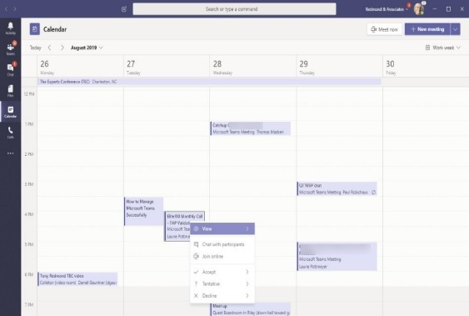
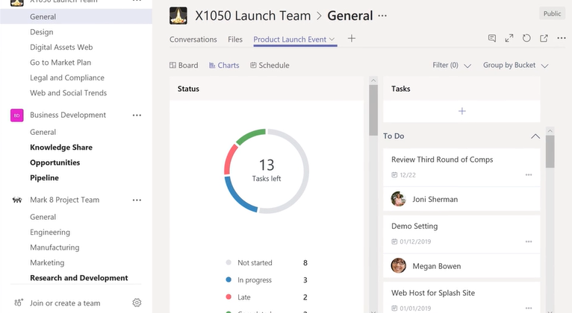
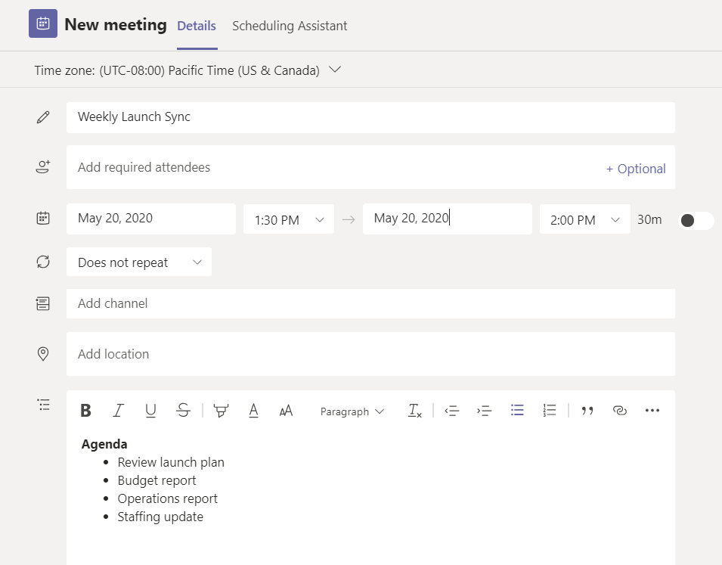
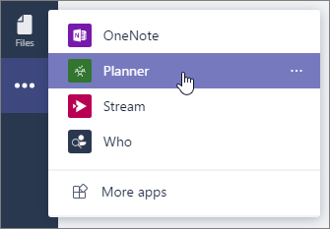
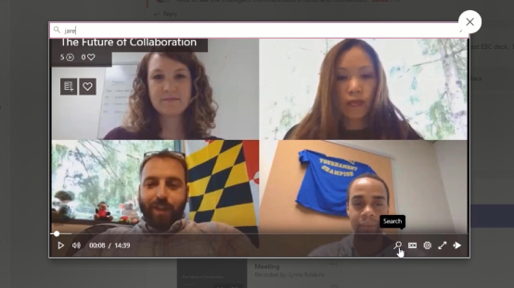

Stay in the flow before, during and after the meeting
Keep context together by chatting with attendees before the meeting begins
Easily take notes, assign tasks, and track projects
Store relevant files, notes and ongoing chats in a shared space
Never miss a meeting with cloud recordings and searchable transcripts
Collaborate on agendas, co-author presentations, and quickly share pre-read materials
Take shared meeting notes with built-in OneNote integration and assign action items with Planner integration
Not all features shown may be immediately available. Please check Microsoft 365 roadmap for latest availability.
Get caught up by searching cloud recorded meeting transcripts for names or keywords
Draw, sketch, and write together on a shared digital canvas with Microsoft Whiteboard and digital ink

Slide 10
“…The key advantage for us is that GitHub brings development and collaboration together in one tool, which gives developers everything they need from a single source and without media discontinuity…”
- Finanz Informatik

Slide 11




























GitHub is the largest developer platform on Earth
40M+
100M+
1,000s
1B+
3M+
50%
Developers
Private and public
repositories
Top open source
communities
Contributions
per year
Organizations
Fortune 500
companies
The most innovative companies
The top open source projects
Leading global enterprises
Largest DevOps ecosystem

Slide 12




End-to-end, code-to-cloud DevOps
Automating workflows from code to any cloud
Home for all developers
Home for the world’s code
Build
Deploy anywhere, including your own data centers
Test
Code
Release
Elastic, to any scale
Fully managed
Always the latest packages
Supports all OS for CI/CD
Largest ecosystem
Community-led automation
On-prem
Azure
AWS
Google Cloud Platform
Plan
Deploy
Monitor
Operate

Slide 13

Team Collaboration
Bring open source culture and best practices into your organization
Increased collaboration
Empower teams to collaborate within your organization
Breaking silos
Simplified collaboration across teams, sharing of knowledge, improved code reuse, and secured workflows
Team Insights
Visibility into team metrics and actionable recommendations to improve team effectiveness and collaboration

Slide 14
“…Customers expect timely and accurate information on their packages and a data-based delivery experience. We’re helping FedEx stay on the leading edge with Azure Machine Learning, and we’re building expertise for future projects…”
- FedEx

Slide 15
44%
Of global organizations say AI has reduced costs¹
AI is demonstrating business impact and gaining momentum
30%
AI investments are set to boost revenue by over 30% over the next four years²
75%
Of enterprises will shift from piloting to operationalizing AI by the end of 2024³
¹ McKinsey: Global AI Survey
² Accenture: The ROI of AI
³ Gartner: Top 10 Trends in Data and Analytics

Slide 16
But there are still barriers to AI adoption
Skills
56% of IT and business leaders cite skill shortage as the biggest challenge to successful AI adoption¹
Scale
76% of executives note struggling when it comes to scaling AI across the business²
Transparency
Gartner predicts that 85% of AI projects will deliver erroneous outcomes due to bias in data, algorithms, or the teams managing them³
¹ Gartner: Barriers to AI Adoption
² Accenture: The ROI of AI
³ Gartner: CIO Agenda Survey

Slide 17
The question is no longer “if or when”, it’s “how”
Digital transformation is an economic imperative
90% of organizations already use the cloud
The cloud is the safest place for your business
Benefits of the cloud are proven

Slide 18

Thank you!
https://aka.ms/cloudgrowth
Sarah Lean
Senior Cloud Advocate
@Techielass
www.techielass.com

